Slide 1
Lecture_04

Slide 2
EXERCISE 15.1 Q.11,23
No. 19

Slide 3

PROBABILITY
Finding Probability : Sum based on Fish
: Sum based on tossing 3 coins

Slide 4

Gopi buys a fish from a shop for his aquarium .The shopkeeper
takes out one fish at random from a tank containing 5 male fish and 8 female fish. What is the probability that the fish taken out is a male fish ?
Sol.
Number of all possible
outcomes of the experiment
= Total number of fish
= 5 male fish
+ 8 female fish
= 13 fish
Let ‘ E ’ be the event that a male fish is picked up.
Number of outcomes favourable to E
How many male fishes are there ?
= 5
Number of outcomes favorable to E
P(E) =
Number of all possible outcomes of the experiment
∴ P(E) =
$$\frac{5}{13}$$

Slide 5
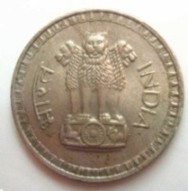
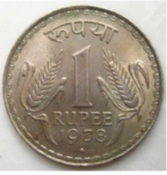








Q. A game consists of tossing a one rupee coin 3 times and
nothing its outcome each time. Hanif wins if all the tosses give the same result i.e., three heads or tails, and loses otherwise. Calculate the probability that Hanif will lose the game.
Sol.
When a coin is tossed 3 times
Possible outcomes are
HHH, HTH, THH, TTH, HHT, HTT, THT, TTT
1st coin/
1st time
2nd coin/
2nd time
3rd coin/
3rd time
1st coin/
1st time
2nd coin/
2nd time
3rd coin/
3rd time
Hanif will lose game if all tosses do not give same result
∴ Total no. of possible outcomes = 8
We know that when a coin is tossed 3 times possible outcomes are
Let A be the event the Hanif will lose the game
Outcomes favourable to A are
HTH, THH, TTH, HHT, HTT, THT
No. of outcomes favourable to A = 6
∴ P (A) =
$$6$$
$$3$$
$$=$$
$$\text{8}$$
$$\text{4}$$

Slide 6
EXERCISE 15.1 Q.3,15
No. 20

Slide 7
PROBABILITY
Finding Probability : Sum based on
Tossing 1 coin
: Sum based on
Playing cards

Slide 8
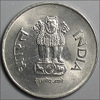
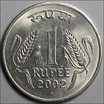
Q. Why is tossing a coin considered to be a fair way of deciding which team should get the ball at the beginning of a football game?
Sol.
When we toss a coin, the outcomes head and tail are equally likely.
So, the result of an individual coin toss is completely unpredictable.
Outcomes are head and tail. These two outcomes are equally likely to occur
H
T

Slide 9
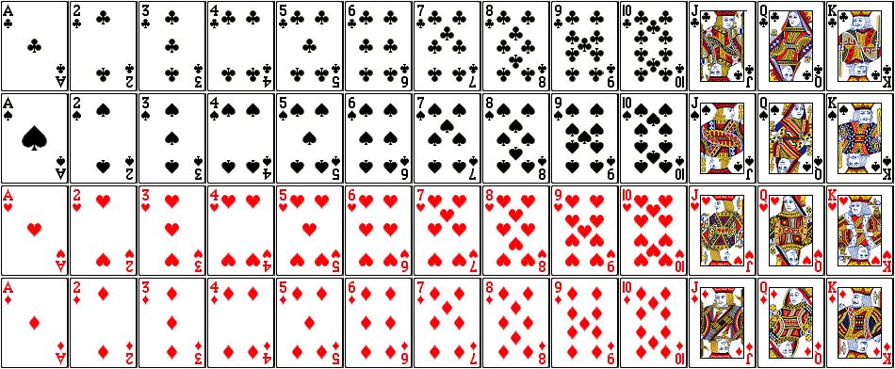


Q. Five cards ___ the ten, jack, queen, king and ace of diamonds, are well - shuffled with their face downwards. One card is then picked up at the random?
(i) What is the probability that the card is the queen?
(ii) If the queen is drawn and put aside, what is the probability that the second card picked up is (a) an ace? (b) a queen?
Sol.
Total number of possible outcomes = 5
Let A be the event that the card picked up is a queen
Number of outcomes favourable to A = 1
$$1$$
∴ P (A) =
$$\text{5}$$
If Queen is drawn and kept aside.
Total no. of possible outcomes = 5 – 1 = 4

Slide 10



Q. Five cards ___ the ten, jack, queen, king and ace of diamonds,
are well - shuffled with their face downwards. One card is then picked up at the random?
(i) What is the probability that the card is the queen?
(ii) If the queen is drawn and put aside, what is the probability that the second card picked up is (a) an ace? (b) a queen?
Sol.
Let B be the event that the card picked is an ace
No. of outcomes favourable to B = 1
$$1$$
∴ P (B) =
$$\text{4}$$
Let C be the event that the card picked is a queen.
No. of outcomes favourable to C = 0
Is there any queen card in these cards ?
NO.
$$0$$
∴ P (C) =
$$= 0$$
$$\text{4}$$

Slide 11
EXERCISE 15.1 Q.14
No. 21

Slide 12
PROBABILITY
Finding Probability : Sum based on
Playing cards

Slide 13
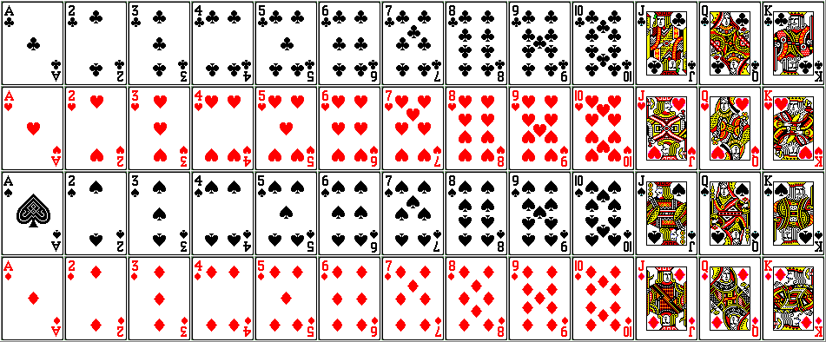


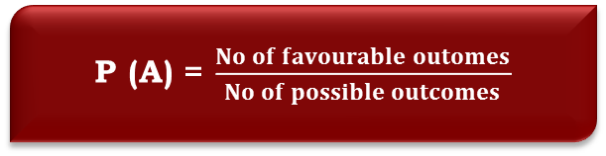












Q. One card is drawn from a well-shuffled deck of 52 cards.
Find the probability of getting
(i) a king of red colour (ii) a face card
(iii) a red face card (iv) the jack of hearts
(v) a spade (vi) the queen of diamonds
Total no. of possible outcomes =
(i) Let A be the event of getting a king of red colour
∴ No. of outcomes favourable to A =
Let B be the event of getting a face card
∴ No. of outcomes favourable to B =
Sol.
52
There are 2 kings of red colour
2
Probability of event B is …. ?
Probability of event A is …. ?
$$1$$
$$2$$
$$1$$
∴ P (A) =
$$=$$
$$52$$
$$26$$
$$26$$
∵ There are 3 face cards in each of the 4 types.
There are 52 cards in a pack
P (A) = $\frac{No of favourable outomes}{No of possible outcomes}$
4 × 3 = 12
$$12$$
$$3$$
$$3$$
∴ P (B) =
$$=$$
$$52$$
$$13$$
$$13$$
Notes:
^

Slide 14










Q. One card is drawn from a well-shuffled deck of 52 cards.
Find the probability of getting
(i) a king of red colour (ii) a face card
(iii) a red face card (iv) the jack of hearts
(v) a spade (vi) the queen of diamonds
(iii) Let C be the event of getting a red face card
(iv) Let D be the event of getting the jack of hearts
∴ No. of outcomes favourable to D =
There are 3 face cards in each of the 2 red cards
No. of outcomes favourable to C =
2 × 3
= 6
$$6$$
$$3$$
∴ P (C) =
$$3$$
$$=$$
$$52$$
$$26$$
$$26$$
There is only 1 Jack of hearts
1
Probability of event D is …?
Probability of event C is ….?
$$1$$
∴ P (D)
$$=$$
$$52$$

Slide 15

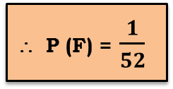






Q. One card is drawn from a well-shuffled deck of 52 cards.
Find the probability of getting
(i) a king of red colour (ii) a face card
(iii) a red face card (iv) the jack of hearts
(v) a spade (vi) the queen of diamonds
Let E be the event of getting a spade
∴ No. of outcomes favourable to E =
(vi) Let F be the event of getting the queen of diamonds
∴ No. of outcomes favourable to F =
∵ There are 13 cards of spade
13
Probability of event F is …?
Probability of event E is …?
$$13$$
$$1$$
$$1$$
∴ P (E) =
$$=$$
$$52$$
$$4$$
$$4$$
∵ There is 1 card of queen of diamonds
1
∴ P (F) = $\frac{1}{52}$

Slide 16
ADDITIONAL EXERCISE
No. 22

Slide 17
PROBABILITY
Finding Probability : Sum based on
Year
: Sum based on
Leap Year

Slide 18
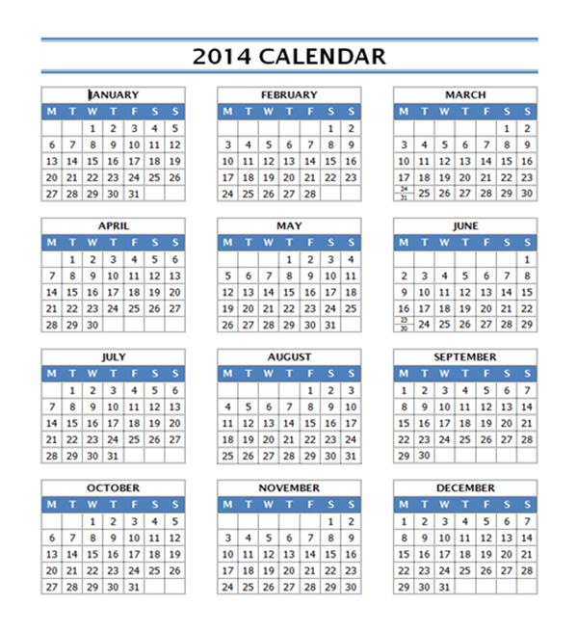

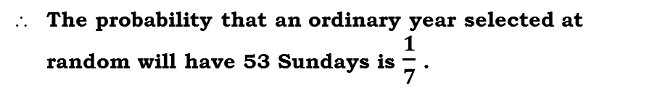
Q. What is the probability that an ordinary year has 53 Sundays ?
Sol.
An ordinary year has 365 days
52 weeks and 1 extra day
Probability of event A is
52 weeks will have 52 Sundays
52 weeks
The possible outcomes for one extra day are
How many days are
there in an Ordinary year ?
Mon, Tue, Wed, Thu,Fri, Sat, Sun
5
Every week has 1 sunday
2
Lets find number of
weeks in 365 days
Total no. of possible outcomes = 7
7
365
Let A be the event that the extra day is a Sunday
–
35
∴ Outcome favourable to A is Sun
From where we will
get 53rd Sunday?
15
52 weeks will have
How many sundays?
Divide 365 days by
7 days i.e. a week
No. of outcomes favourable to A = 1
–
14
$$\frac{Number of outcomes favourable to A}{Total no. of possible outcomes}$$
1
P (A) =
Extra day may give us
an extra Sunday
i.e. 53rd Sunday
∴ P (A) =
1 extra day
The probability that an ordinary year selected at random will have 53 Sundays is $\frac{1}{7}$ .

Slide 19
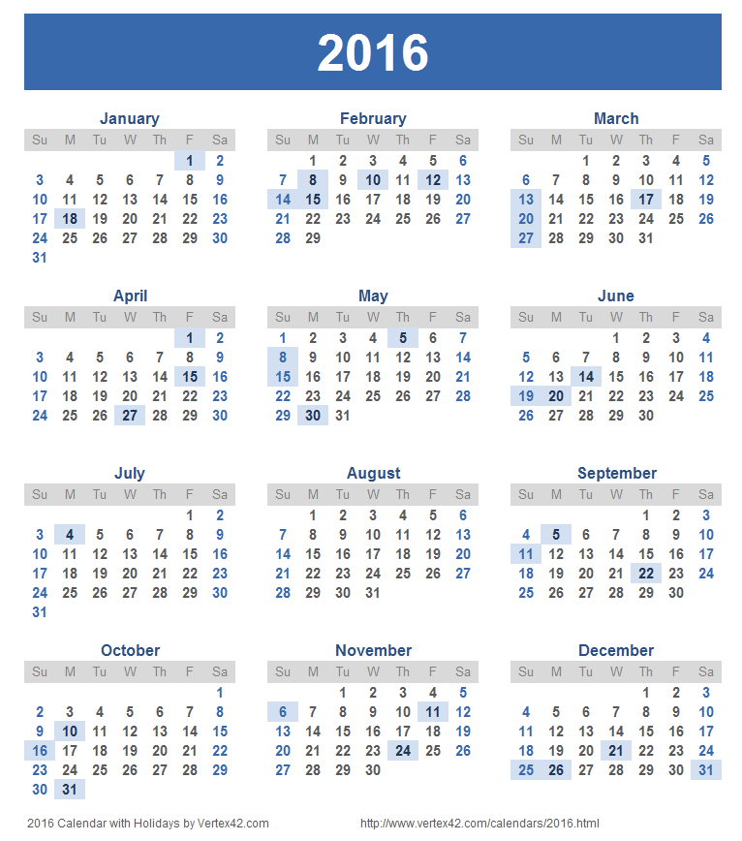
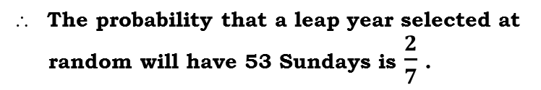

Q. What is the probability that a leap year has 53 Sundays ?
Sol.
A leap year has 366 days
52 weeks and 2 extra days
52 weeks will have 52 Sundays
52 weeks
The sample space for 2 extra days
All possible outcomes are Sun - Mon,
Mon - Tue,
5
2
Tue - Wed,
Wed - Thu,
Thu - Fri,
Fri - Sat,
Sat - Sun
7
366
∴ Total no. of possible outcomes = 7
–
Probability of event A is
35
How many days are
there in a Leap year?
Two extra days will be two consecutive days.
Lets find number of weeks
in 366 days
Let A be the event of getting 53rd Sunday in remaining 2 days
Every week has 1 sunday
From where we will
get 53rd Sunday?
16
–
14
∴ Outcomes favourable to A is
Sun – Mon, Sat - Sun
Divide 366 days by
7 days i.e. a week
No of outcomes favourable to A = 2
52 weeks will have
How many Sundays?
2
2 extra days may give
us an extra Sunday
i.e. 53rd Sunday
P (A) = $\frac{ Number of outcomes favourable to A}{Total no. of possible outcomes}$
2 extra days
∴ P (A) =
The probability that a leap year selected at
random will have 53 Sundays is $\frac{2}{7}$ .

Slide 20
ADDITIONAL EXERCISE
No. 23

Slide 21
PROBABILITY
Finding Probability : Sum based on
3 Horses

Slide 22

Q. Three horses A, B and C are in a race, A is twice as like to win as B
and B is twice as like to win as C, what are their probabilities of winning ?
Sol.
Let probabilities of horses A, B and C be P (A), P (B), and P (C).
P (A) = 2P (B) .......(i)
P (B) =
Substituting (ii) in (i),
P (A) = 2
∴P (A) =
Assuming only one of them is going to win the race
∴ P (A) + P (B) + P (C) = 1
∴ 7P (C) = 1
2 P(C)
.....(ii)
Probabilty of Horse A winning the race or Horse B winning the race or Horse C winning the race are equally likely to occur
2 P(C)
Probability of horse C winning the race
Probability of horse B winning the race
Since we don’t know anything about the ability of the horses
Probability of horse A winning the race
Hence they are elementary events
We know sum of probabilities of all elementary events = 1
× 2 P(C)
P(B)
4 P(C)
.....(iii)
4 P(C)
Substituting the value of P (C) in (ii),
∴
+
+ P (C)
= 1
P (B) =
∴
P (C) = $\frac{1}{7}$
∴ P (B) = $\frac{2}{7}$
Substituting the value of P (C) in (iii),
P (A) =
∴ P (A) = $\frac{4}{7}$

Slide 23
ADDITIONAL EXERCISE
No. 24

Slide 24
PROBABILITY
Finding Probability : Sum based
on Birthday

Slide 25
Q. Savita and Hamida are friends, what is the probability that both will
have (i) the same birthday (ii) different birthdays (ignoring a leap year).
SAME
DAY
DIFFERENT
DAY
Sol.
All possible outcomes are
No. of outcomes with birthday on different day =
Total No. of outcomes – No. of outcomes with Birthday on same day
{ (1,1),
(1,2),
(1,3),
(1,365),
………’
(2,1), (2,2), (2,3), ………, 2,365),
If we observe all the elements on the diagonal , we observe that both their birthdays fall on the same day
(3,1), (3,2), (3,3), ……, (3,365),
365 rows
…………
Hamida’s birthday on 3rd Jan
i.e. 3rd day of year
…………
…………
…………
Hamida’s birthday on 1st Jan
i.e. 1st day of year
Savita’s birthday on 2nd Jan
i.e. 2nd day of year
Hamida’s birthday on 31st Dec
i.e. 365th day of year
Hamida’s birthday on 2nd Jan
i.e. 2nd day of year
Since there are 365 rows ,there are 365 diagonal elements
(365,1),(365,2),(365,3) ,………….., (365,365) }
Hamida’s birthday on 3rd Jan
i.e. 3rd day of year
Hamida’s birthday on 2nd Jan
i.e. 2nd day of year
Probability of event A is
Hamida’s birthday on 1st Jan
i.e. 1st day of year
Probability of event B is
Let B be the event that both Savita and Hamida have their birthday on different days
Total no. of possible outcomes = 365 x 365
∴ n (B) =
365 x 365
365 columns
- 365
= 365 ( )
365 - 1
Let A be the event that both Savita and Hamida have their birthday on same day
∴ Number of outcomes favourable to B is 365 x 364
Savita’s birthday on 1st Jan
i.e. 1st day of year
∴ Number of outcomes favourable to A = 365

Slide 26
Thank You

